Slide 1


HEART DISEASE PREDICTION
TEAM MEMBERS:
Aakash Sarap
Anish Nitin Somaiah
Shivani Grover
Sushmita Jadhav
Instructor: Valeriy Shevchenko
CRN: 21282
Course: ALY 6015: Intermediate Analytics

Slide 2


Slide 3

Introduction

Slide 4

About the dataset
Dataset is retrieved from UCI Machine learning repository retrieved from https://archive.ics.uci.edu/ml/datasets/heart+Disease
It contains 14 attributes for prediction.
The Result column is our prediction output in which 0 refers to patients without and 1 refers to patients with heart disease.

Slide 5
Business Questions
What are the factors that effect heart disease?
What is the relationship between factors and possibility of heart disease?
How strong is the relationship between factors and possibility of heart disease?

Slide 6

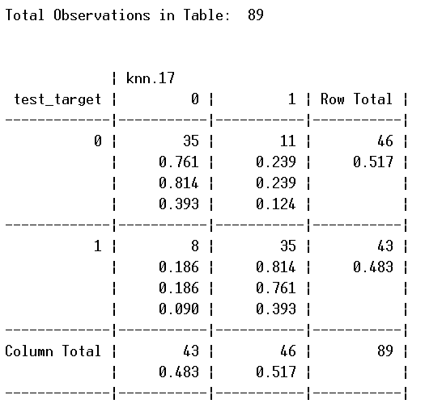
KNN Classification
Accuracy rate = 78.65%

Slide 7
Explanation of Cross Table
Test data set has 46 observations who are observed to have no heart disease while 43 observations have the disease.
The KNN method predicts 43 of the people with no heart disease and 46 have disease
70 of the observations in the test data set are predicted correctly.
19 observations are incorrectly predicted i.e. 11 belong to people with no heart disease but are predicted to have heart disease while 8 of them are predicted to not have heart disease while they actually have.

Slide 8
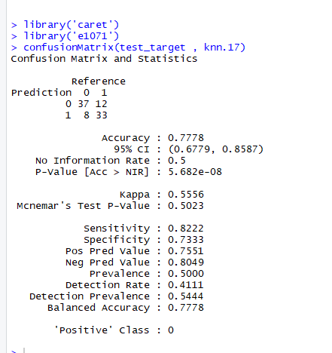
CONFUSION MATRIX

Slide 9
Explanation of confusion Matrix
From the confusion matrix we can observe that 37 observations are true negatives, 33 are true positive, 8 and 12 are false negative and positive respectively.
This indicates our 78% accuracy of the prediction model.
Moreover sensitivity (proportion of people with disease and positive result) of the test is 82.2% and the specificity (proportion of people without disease and negative result) of the test is 73.3%.
Balanced accuracy and actual accuracy are same indicating that the accuracy cannot be improved than the acquired 78% value.

Slide 10
LOGISTIC REGRESSION

Slide 11

Logistic Regression for females dataset
Regression Model
Y=2.166*chest_pain +0.067*resting_bp+1.71*number of major vessels colored + 3.02*thalium heart scan – 42.39
P(Y)=1/1+e^(-Y) (model equation)

Slide 12
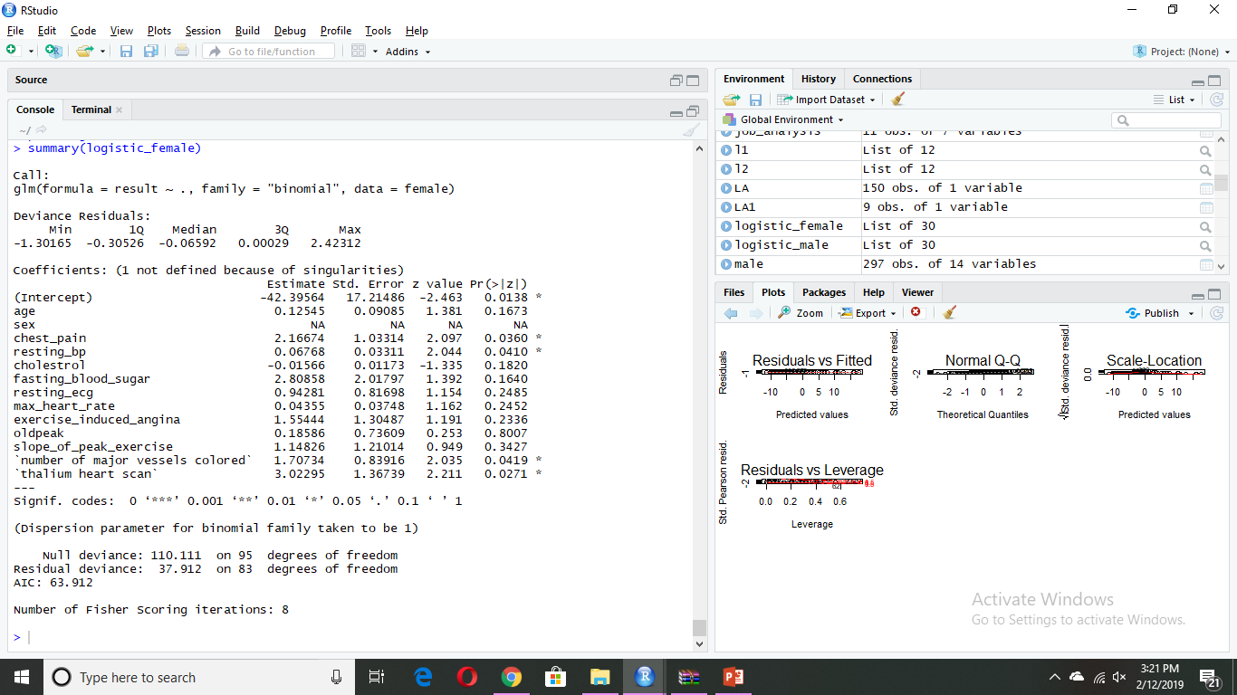
A logistic regression is done for the female subset to find out the best predictor variables for our given dataset.
It has been observed that 4/14 variables form the optimum predictor variables for the female subset.

Slide 13
Logistic Regression for males dataset
Regression Model
Y=0.578*chest_pain + 1.26*number of major vessels colored + 0.71*thalium heart scan - 10.2
P(Y)=1/1+e^(-Y) (model equation)

Slide 14
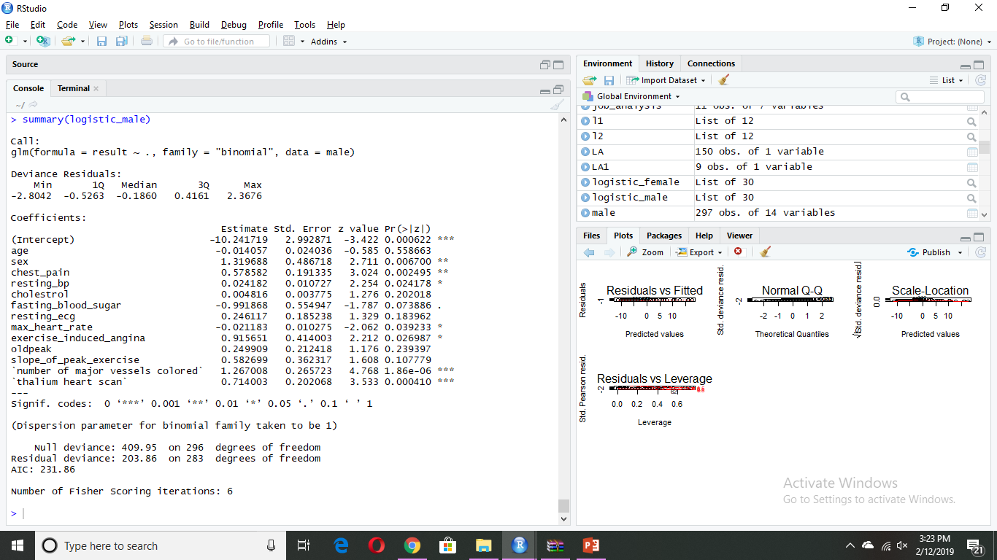
A logistic regression is done for the male subset to find out the best predictor variables for our given dataset.
It has been observed that 6/14 variables form the optimum predictor variables for the male subset.
We consider only 3 variables namely number of major vessels colored, thallium heart scan and chest_pain in our regression model because of its very low significant P values compared to the others

Slide 15
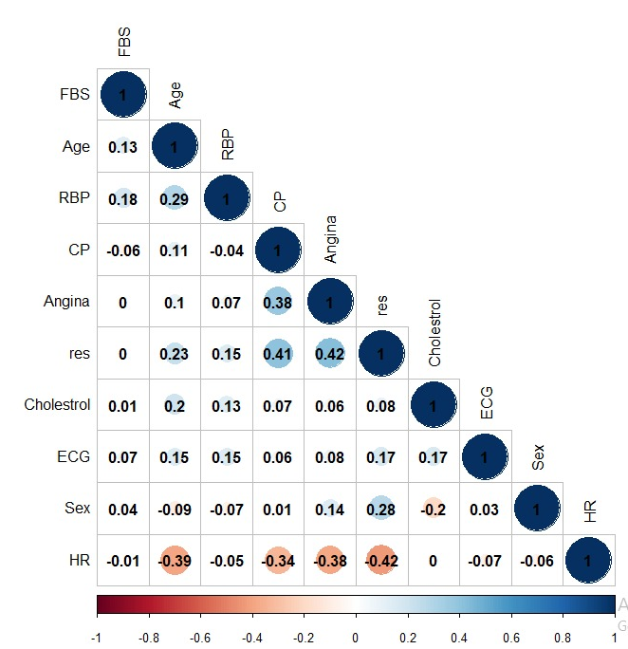
CORRELATION MATRIX

Slide 16
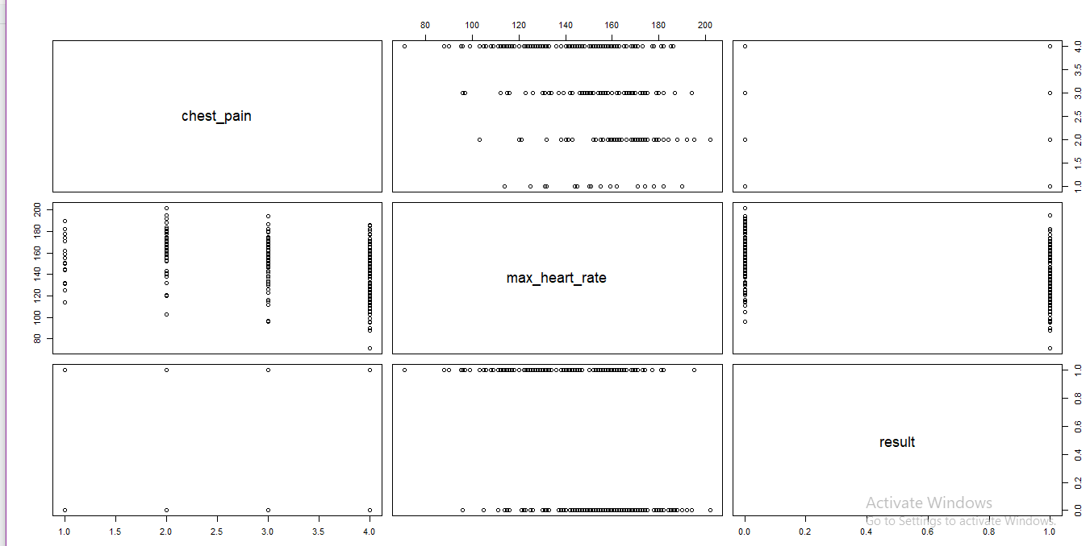
SCATTER MATRIX

Slide 17
Explanation of the correlation and scatter matrix
From the above 2 plots we find out the correlation between our predicted variables and our prediction result which is whether an incoming patient has heart disease or not.
From the above plots we infer that there is a huge correlation value for result with max heart rate, chest pain as declared above using regression methods as well.
From the above scatter matrix we also infer that there is a negative correlation between result and maximum heart rate and a positive correlation between result and chest pain

Slide 18
Prediction Variables Analysis Plots

Slide 19
Plot Analysis
To verify our prediction we took a dataset for a similar age group (59 years) and analyzed the data pattern.
From the above plots we can see that for max heart rate, people with heart disease have lower max heart rate compared to the people without heart disease proving the negative correlation between result and max heart rate variables.

Slide 20
Plot Analysis Contd
For number of vessels colored we prove a positive correlation as the number is greater for people with heart disease compared to people without.
One significant observation in the plot is that there are 2 cases where both counts are equal. This is because our prediction model is only 78% accurate which we inferred during the KNN classification.

Slide 21
Conclusion
We found the factors that affect prediction of heart disease using logistic regression.
We also found out the relationship between the factors and result using Correlation matrix and scatter plot matrix.
We also inferred the strength of correlation and accuracy of our prediction model using KNN cross table and confusion matrix.
Our prediction model states that 4 predictor variables out of the total 17 play a significant role in our prediction model with 78% accuracy.

Slide 22
REFERENCES
Idre (n.d) ‘Logit Regression | R Data Analysis Examples’. Retrieved from https://stats.idre.ucla.edu/r/dae/logit-regression/
Statistics How to (n.d) ‘Sensitivity vs Specificity vs Predictive Value. Retrieved from https://www.statisticshowto.datasciencecentral.com/sensitivity-vs-specificity-statistics/
Data School (March 25, 2014) ‘Simple guides to confusion matrix terminology’ Retrieved from https://www.dataschool.io/simple-guide-to-confusion-matrix-terminology/

Slide 23
THANK YOU

